Slide 1
api/vehicleCode/transfer-end
When transfer end, user can get point.
But this point is from admin setting. Not user.
Now I checked android API. But there is key name is “point”. And this value is saved in DB now. So we have to fix this.

Slide 2
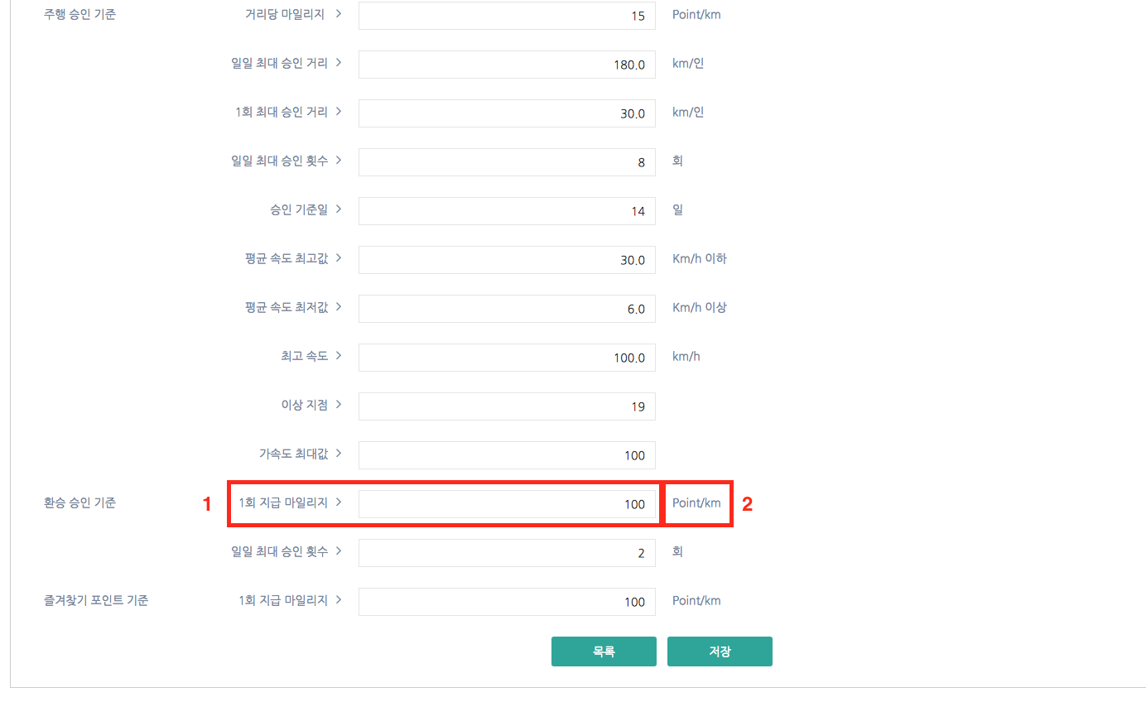
http://ecomileage.tramsdev.co.kr/auth/mileage/approval/edit?id=6
In this page there is transfer-point.
So if user transfer, user can get this point.
After transfer end, User can get point from 1.
And pls change text 2 -> “1회”

